Slide 1
"Leveraging Temperature Forecasting for Strategic Planning"
Team-1
Team Members:
Bhuvaneshwar Reddy Muddam
John Gebhard
Sai Harish Boddu
Srinivas Minnakanti
Tejaswini Gudisi
Tejesh Hawalgi

Slide 2
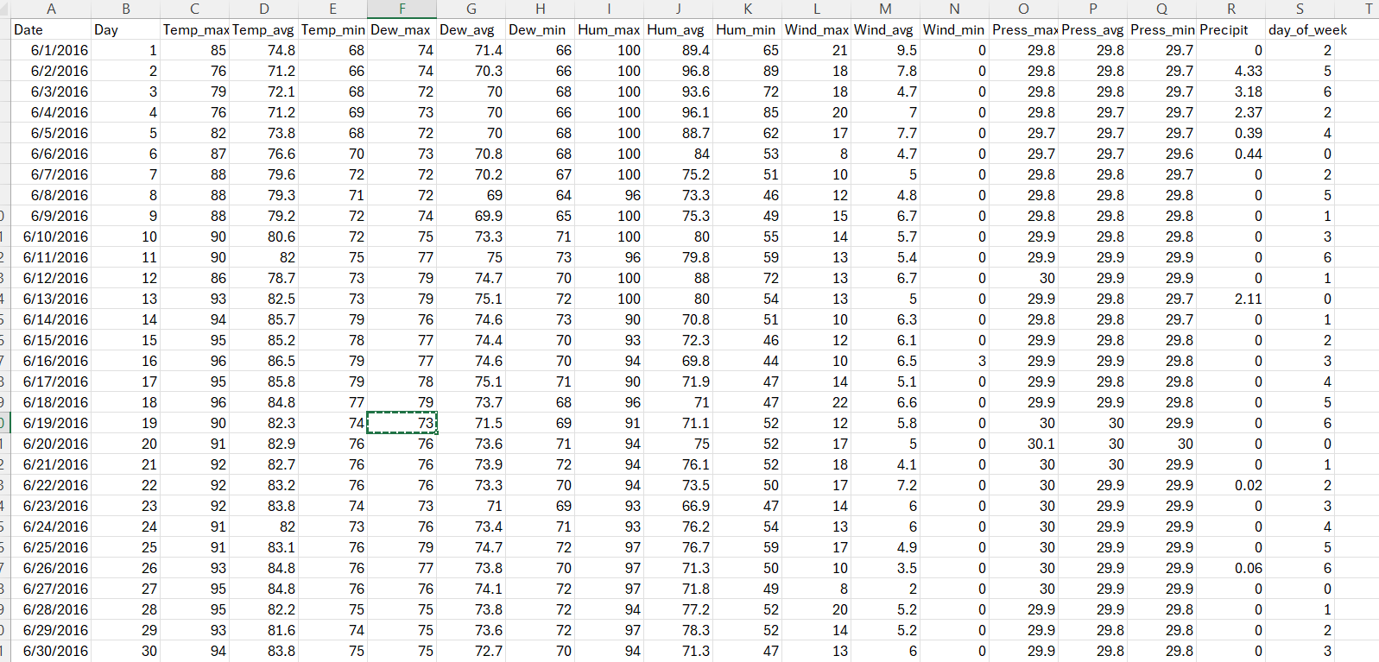
Data Extraction and Refinement
⇾ Houston, Texas Dataset
⇾ Daily Data
⇾ Forecasting Variable- Temp_avg
⇾ Rows- 1552
⇾ Columns- 19
⇾ Columns used- 6

Slide 3
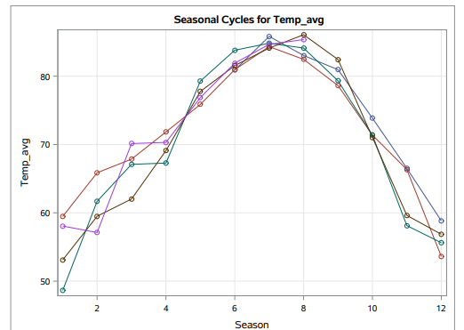
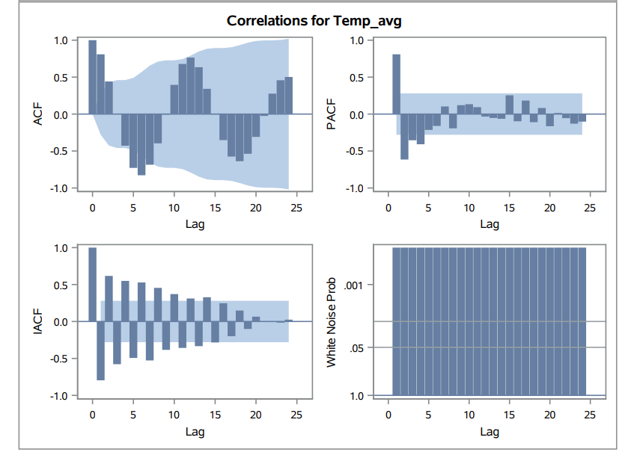
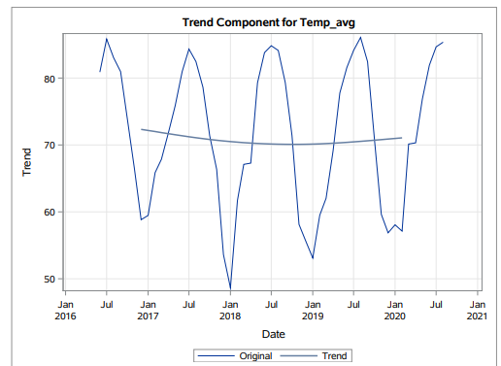
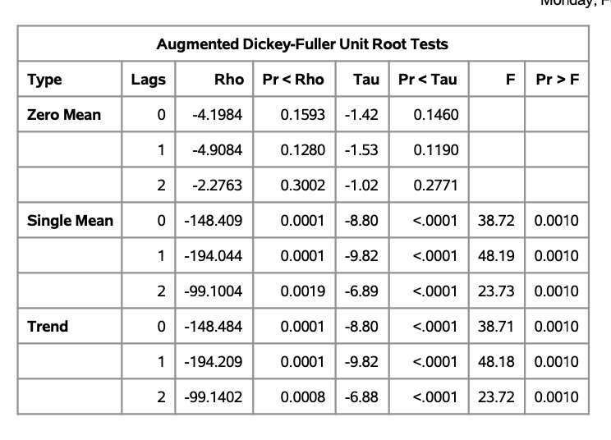
Time series dataset preparation and exploration
⇾ The graphs show seasonality but no trend
⇾ White noise is not distributed.
⇾ Stationary data.

Slide 4
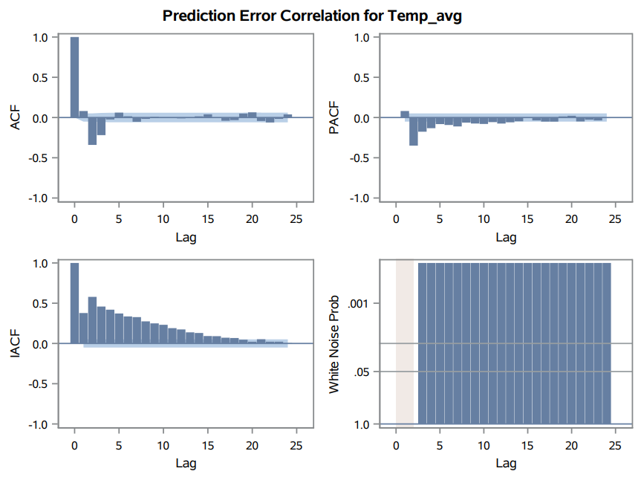
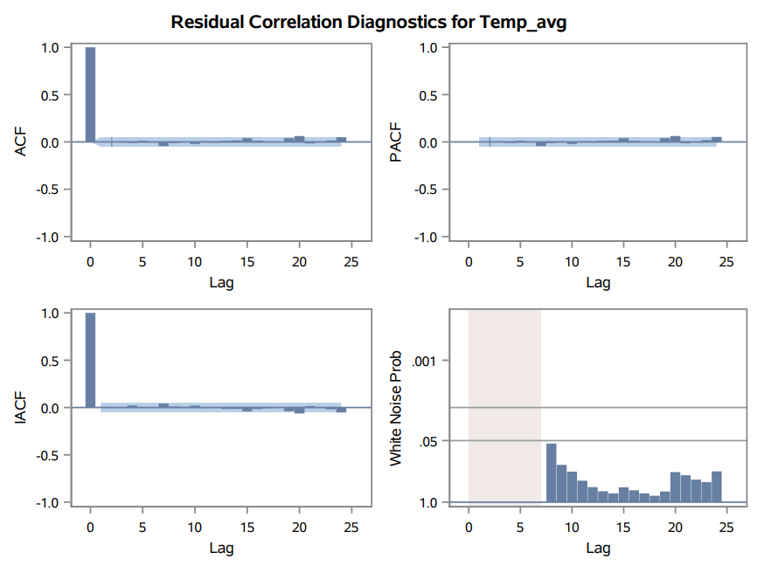
Exponential smoothing
ARIMA
⇾ From exponential smoothing we can see white noise is not distributed.
⇾ In the ARIMA with p=4, q=3 our white noise is distributed.

Slide 5
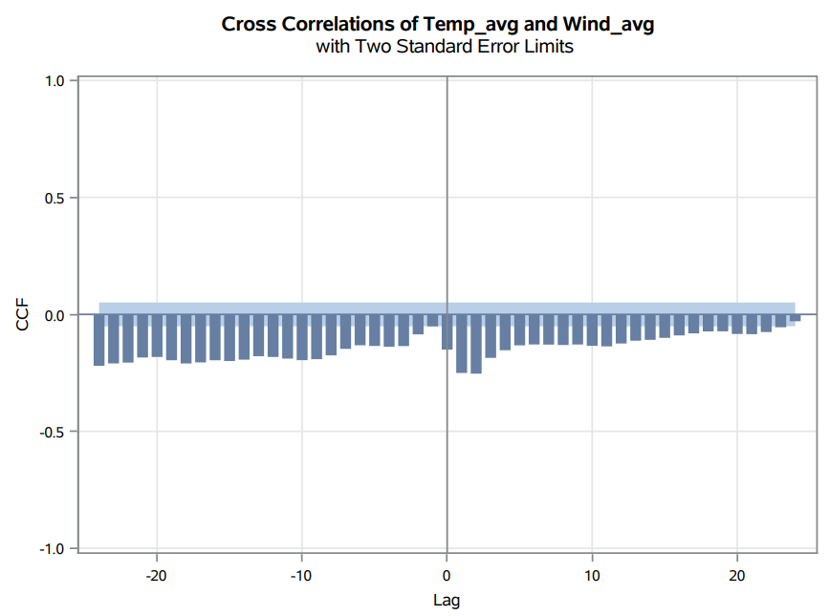
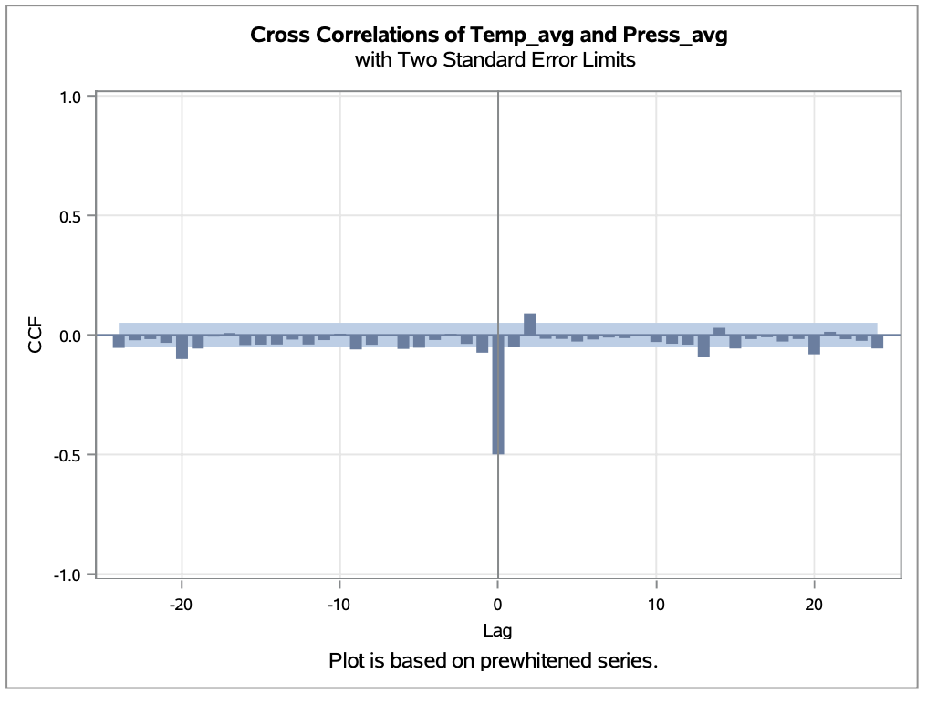
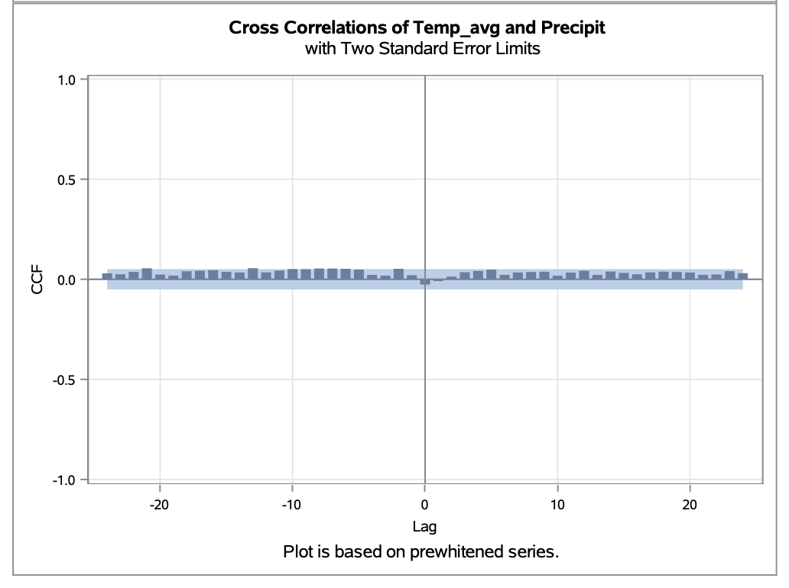
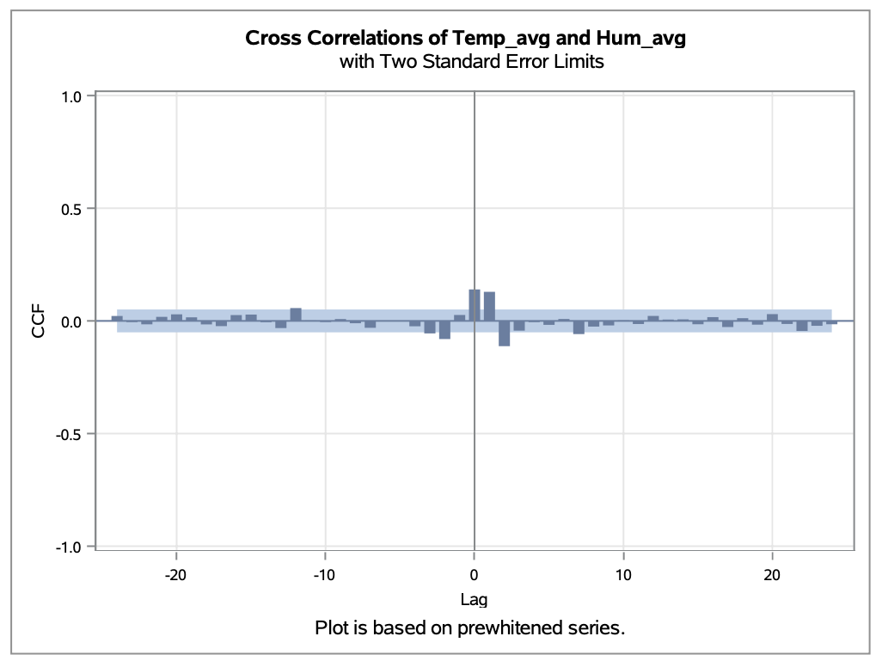
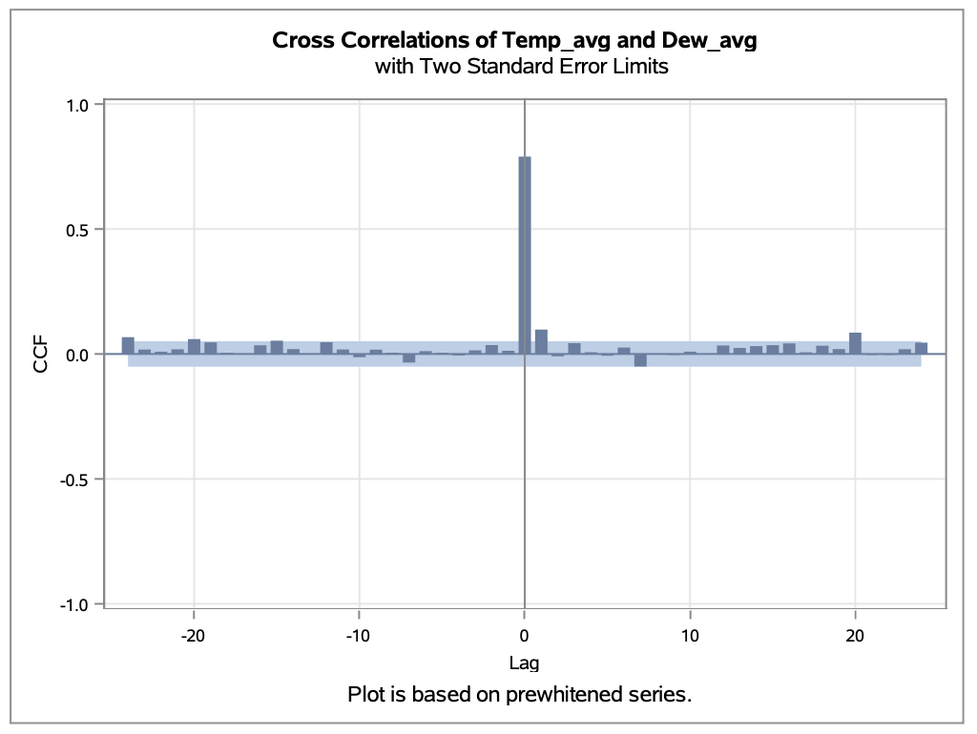
Pre-whitening
⇾ Wing_avg has lag1 effect.
⇾ Precipit has no effect.
⇾ Other variables have lag 0 effect.

Slide 6
Model Comparison
Model | p | d | q | P | D | Q | AIC | SBC | MAPE
Additive seasonal ESM | - | - | - | - | - | - | 5245.14 | 5255.82 | 5.94%
ARIMA | 4 | 0 | 3 | 0 | 0 | 0 | 9320 | 9362.78 | 5.44%
ARIMAX | 1 | 0 | 0 | 0 | 1 | 0 | 3910.77 | 3942.82 | 0.46%
ARIMAX | 7 | 0 | 0 | 0 | 1 | 0 | 3586.67 | 3650.78 | 0.40%
ARIMAX | 7 | 0 | 0 | 0 | 0 | 0 | 2985.41 | 3049.57 | 0.37%

Slide 7
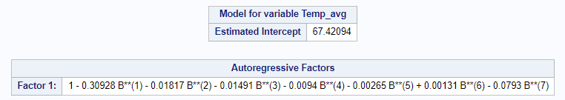
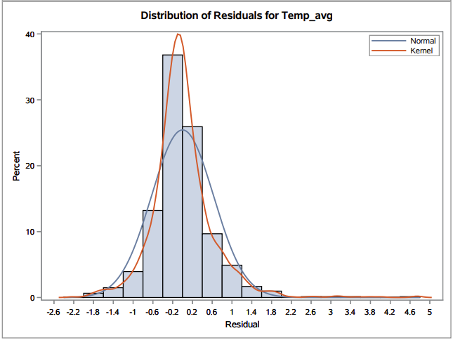
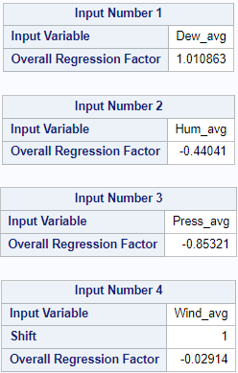
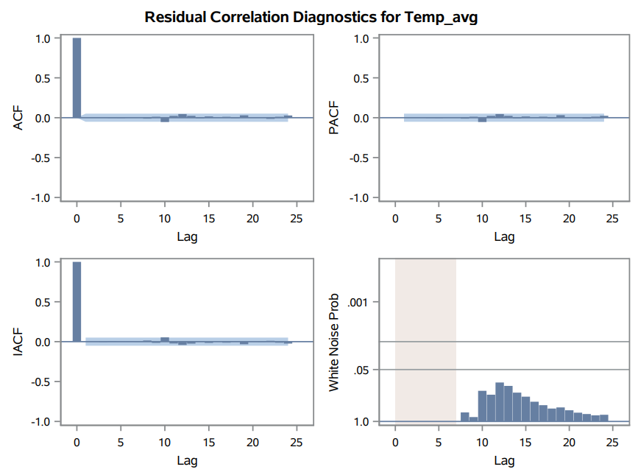
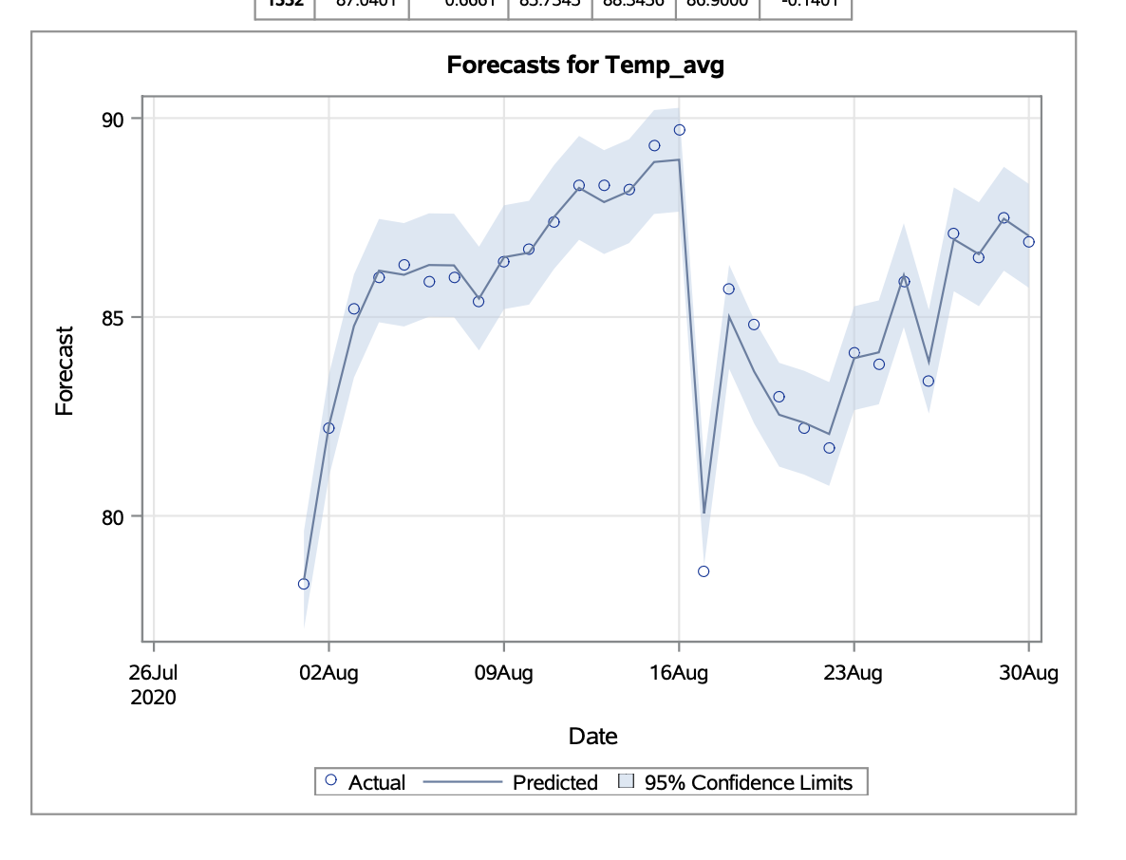
Best Model
⇾ ARIMAX (7,0)
⇾ Independent Variables :- Dew, Humidity, Pressure & Wind.
⇾ Passes white noise test.

Slide 8
Conclusion
ARIMAX outperforms Additive Exponential Smoothing and traditional ARIMA models
ARIMAX model achieved superior forecasting accuracy, as evidenced by lower MAPE and improved goodness-of-fit metrics
Incorporating lag effects of wind speed significantly improved forecasting accuracy

Slide 9
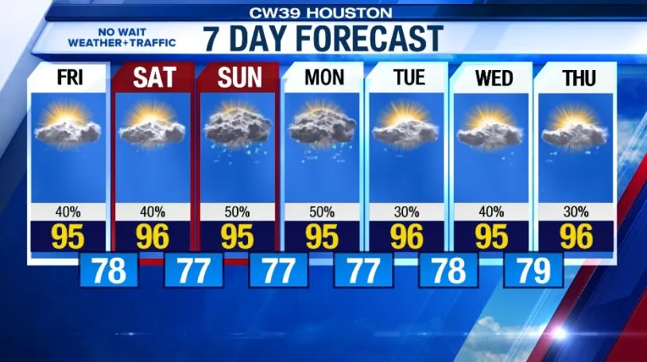
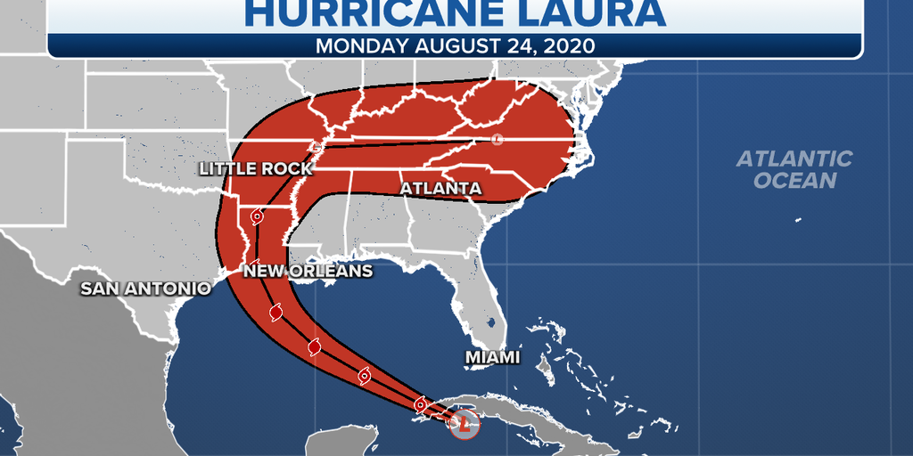
Importance of Weather Forecasting Models
(National Academies of Sciences, Engineering, and Medicine)
Weather Reliant Industries:
Construction
Agriculture
Energy
Catastrophic Weather Events
Long-term Implications
Notes:
To close out our presentation, I’m now going to discuss the importance of a forecasting model such as ours. Predicting weather temperature can be extremely important, both in the short and long term. I’ll start by sharing a fact with the source listed on the screen behind me.
The estimated annualized benefit of investing in public weather forecasts is about $31.5 billion
In addition to being financially beneficial, temperature forecasting models can also be extremely practical. The morning weather on the news is entirely based on forecasting models. Granted they have extremely sophisticated equipment and capabilities, the same principle as our model still applies.
Many industries such as construction, agriculture, or energy are incredibly reliant on knowing future weather patterns. Predicting severe weather events such as hurricanes, tornadoes, or floods can truly mean the difference between life or death. Knowing that a storm is approaching allows communities and first responders to take appropriate precautions and some cases, evacuations.
Equally as important is understanding the long-term effects of changing weather patterns. While our data showed very little trend, we used a tiny sample size relative to what’s needed for conditions 10s or even 100s of years down the line. Significant trends might empower lawmakers or businesses to enact legislation or develop strategies to mitigate the changing conditions.

Slide 10
Thank you

